Slide 1

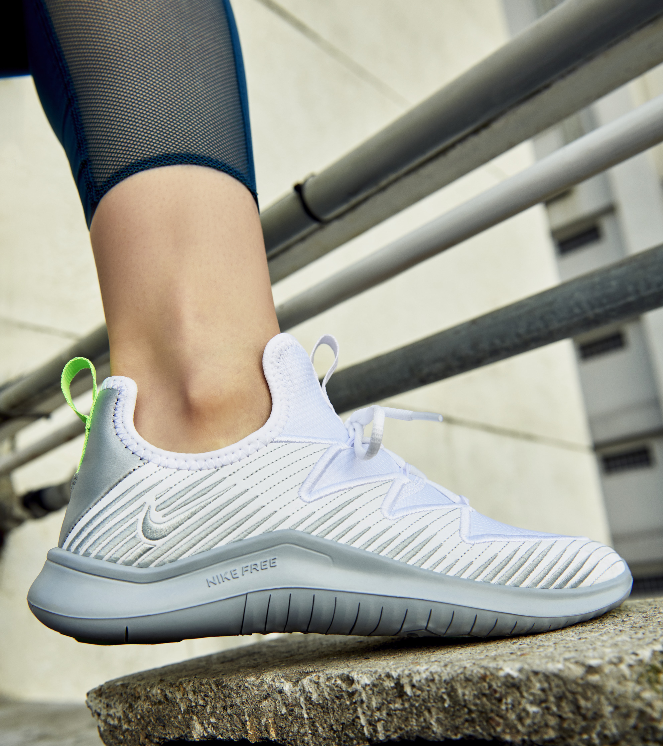
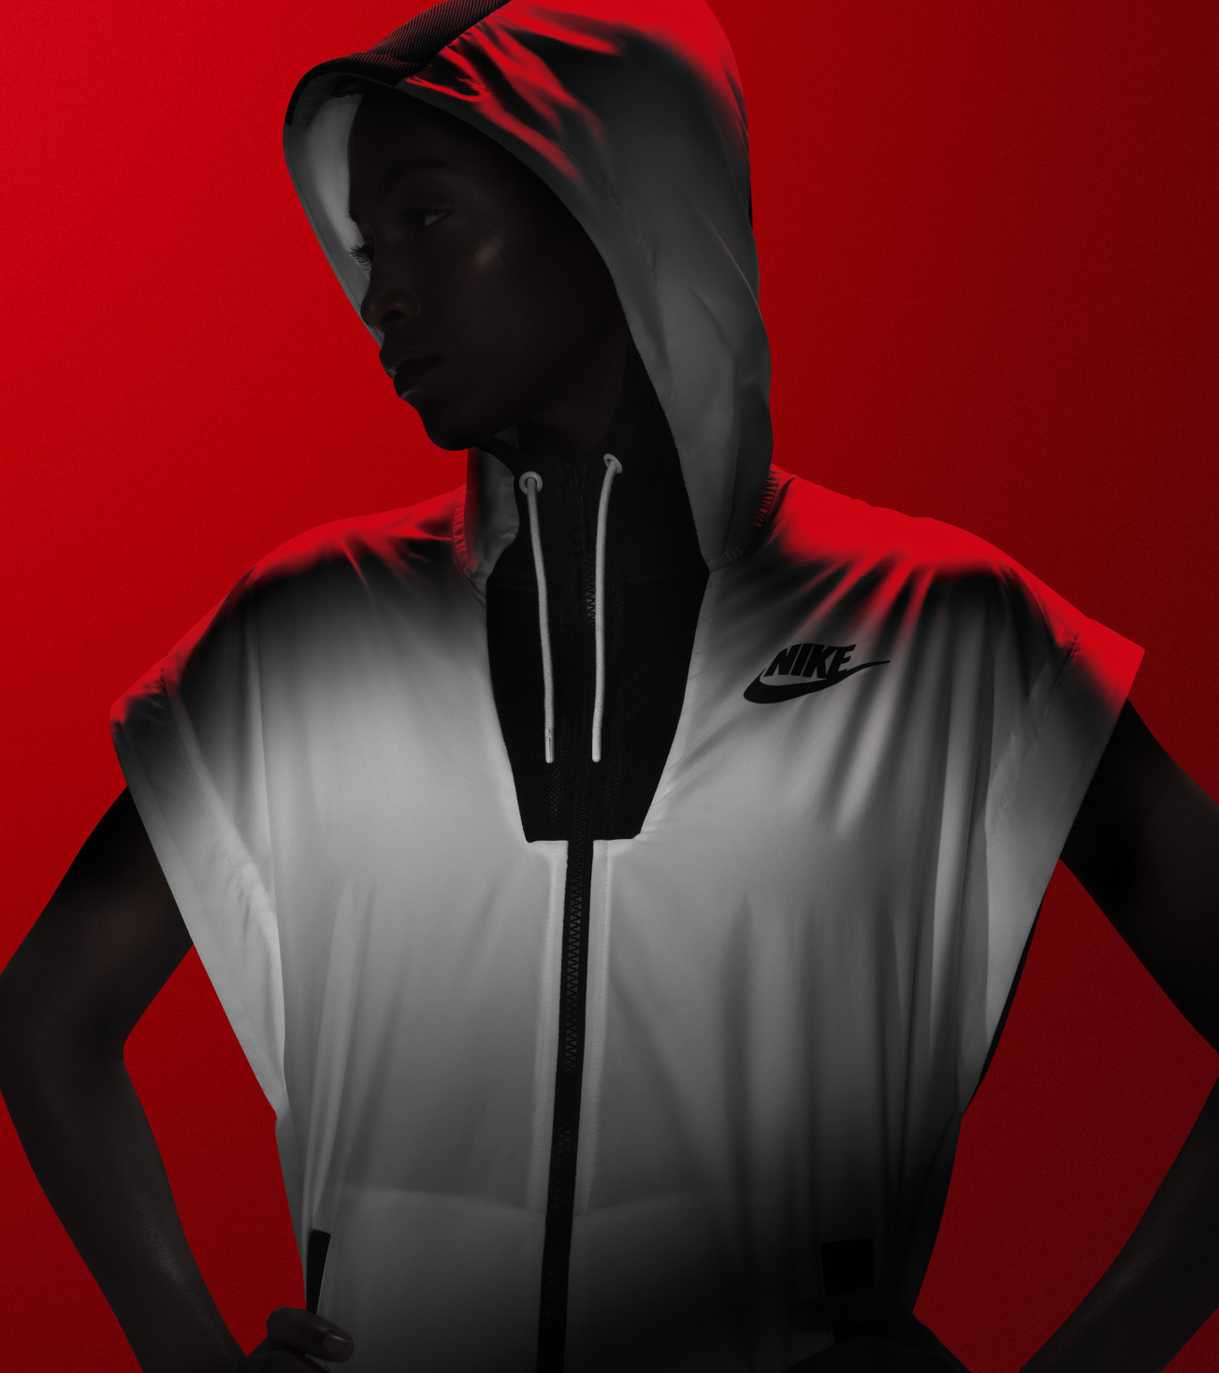
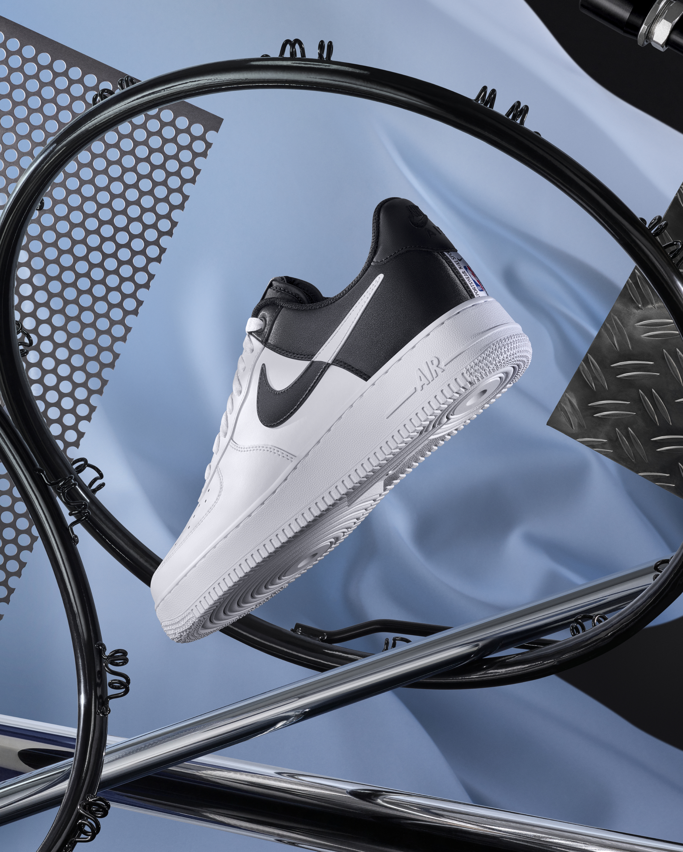
PROBLEM
SEE SOMEONE WEARING A COOL NIKE SHOE
MISSED PURCHASE OPPORTUNITY FOR NIKE
DON'T KNOW THE SHOE MODEL, CAN'T FIND IT ONLINE
MARK
Notes:
Brian- The previous scenario is an example of a missed purchase opportunity for Nike.
As you all saw, Jason was unable to remember the particular model name of his shoes, much less where his shoes were purchased from.
Nike must look to take advantage of any consumer's initial "Wow Factor" when they see a shoe they like, and produce a sales conversion instantly.

Slide 2
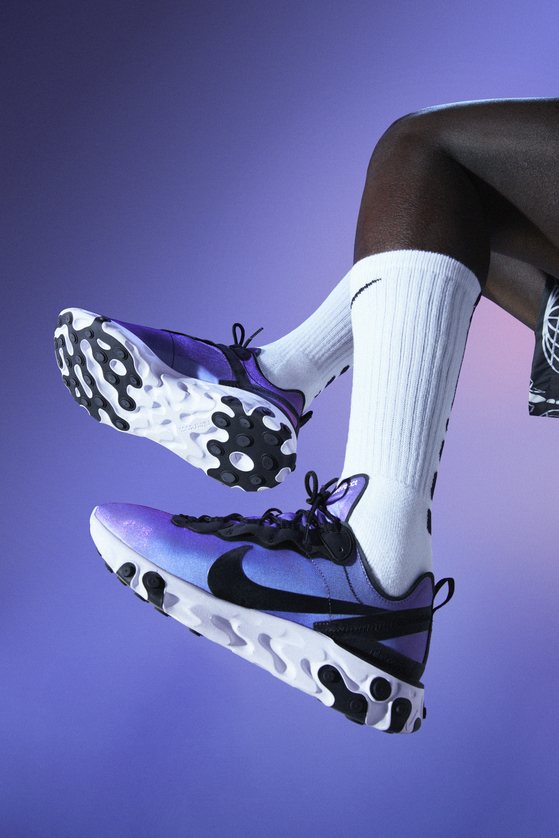
MUST ACQUIRE RECENT KICKS
Notes:
We bring to you today, our team's product, the revolutionary Mark app. MUST ACQUIRE RECENT KICKS
Our MARK app would address the specific use case of an individual seeing someone wearing a cool Nike shoe and streamlining them to purchasing that shoe instantly.

Slide 3

FY19 FOOTWEAR REVENUE
NORTH AMERICA
EMEA
$10B
$6.3B
TOTAL
FOOTWEAR
$24B
GREATER CHINA
APLA
$4.3B
$3.6B
MARK
Notes:
Kami –
Footwear is Nike’s greatest source of revenue. Here are the numbers reflecting footwear revenue in the different geos for FY19. Behind these numbers, however, we still see a challenge for Nike and opportunity for innovation.

Slide 4
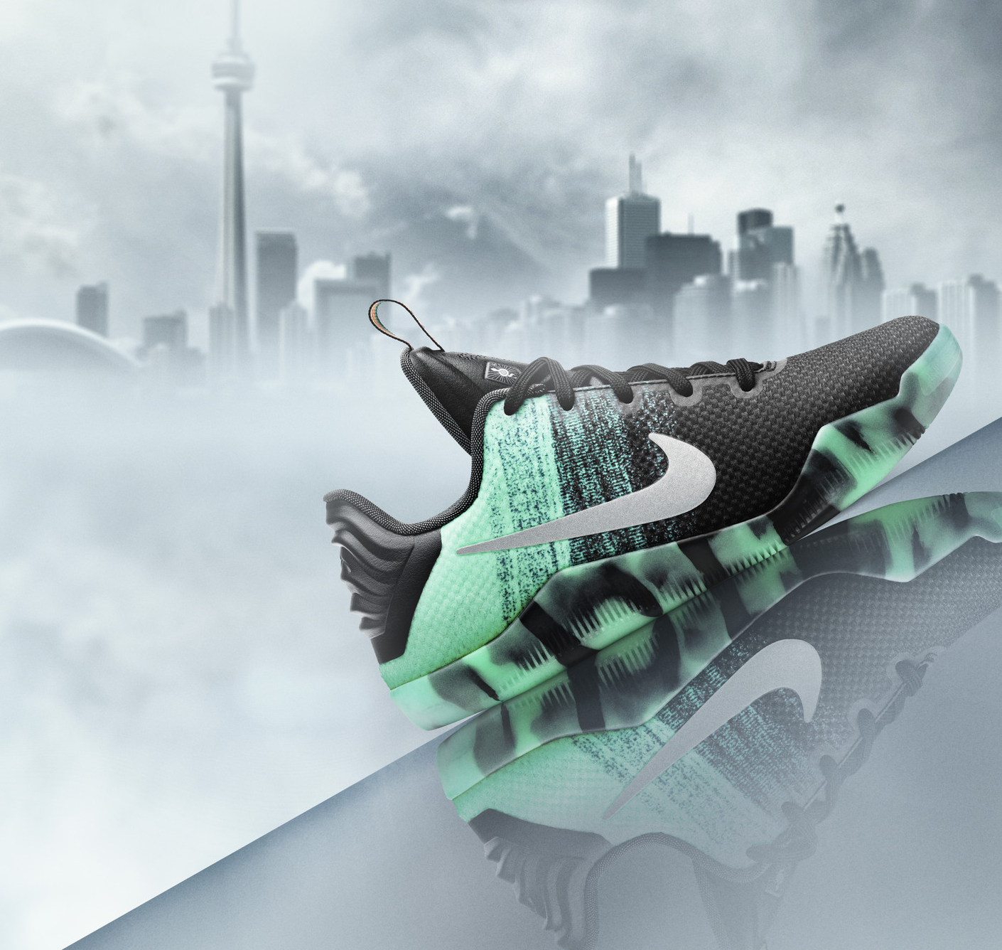
PDP JUNE 2019 AVERAGES
Desktop
traffic
Conversion
rate
PURCHASES
2.57M
2.2%
56,540
mobile
traffic
Conversion
rate
PURCHASES
3.2M
0.47%
15,040
MARK
Notes:
Kami –
With these monthly averages, we see an area for huge possible improvement. Mobile traffic to Nike.com is much higher than desktop, yet its conversion rate is way lower. This translates to 56 thousand purchases on desktop, and only 15 thousand on mobile per month.
If MARK can help increase mobile conversion rate to just 0.75% or 1%, this still translates to tens of thousands more purchases per month. Now John will explain of how we’ve worked towards this solution.

Slide 5
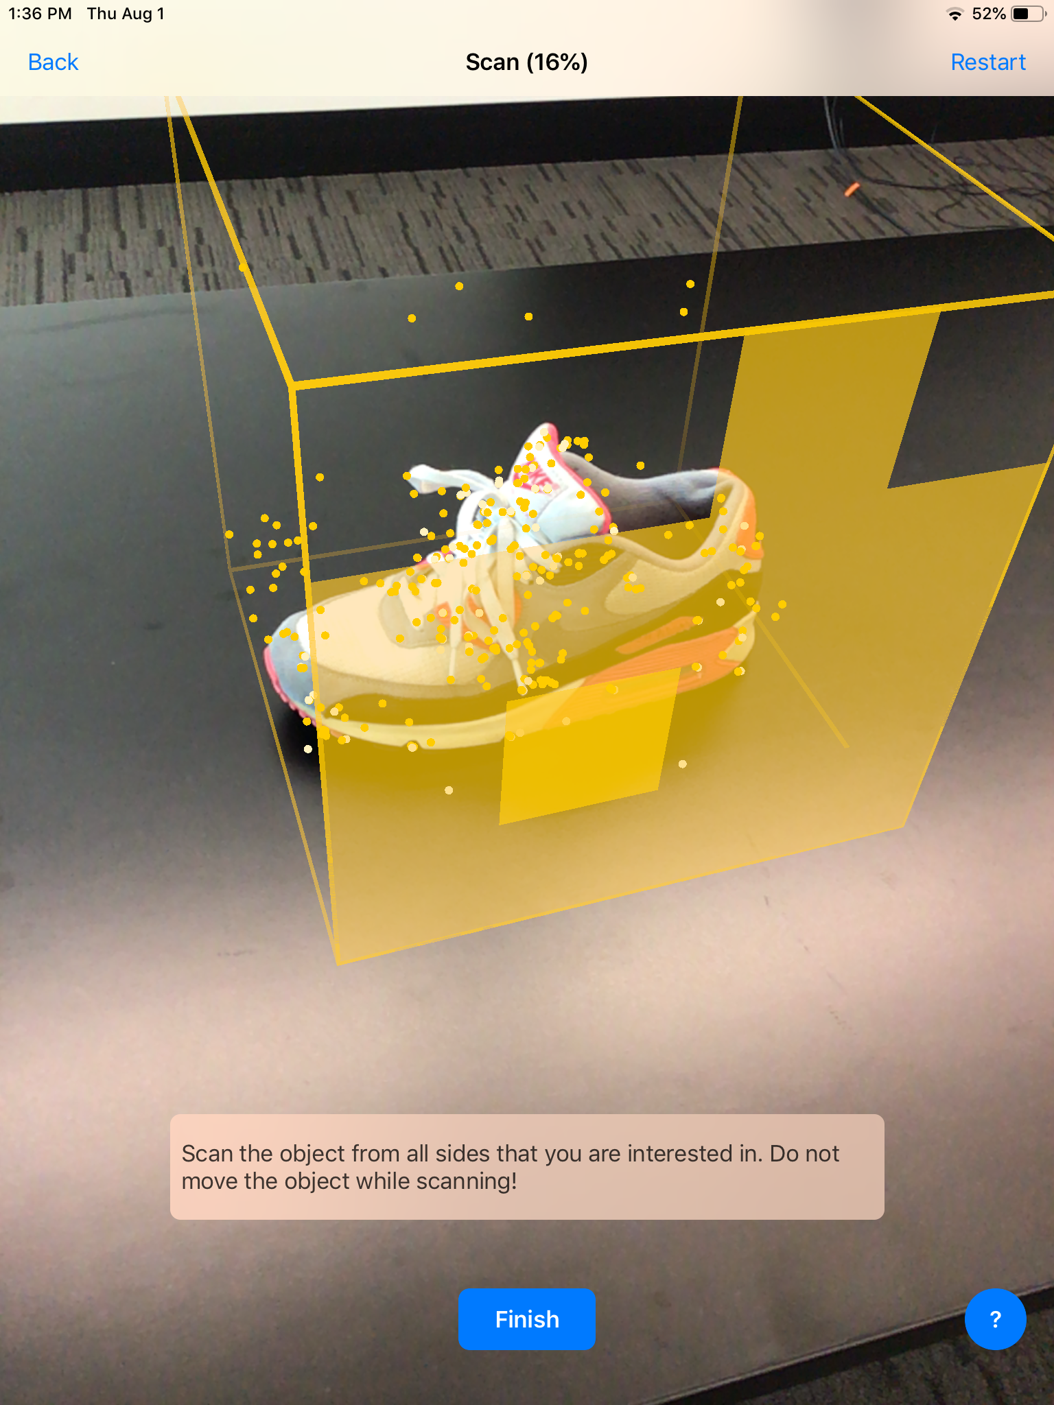
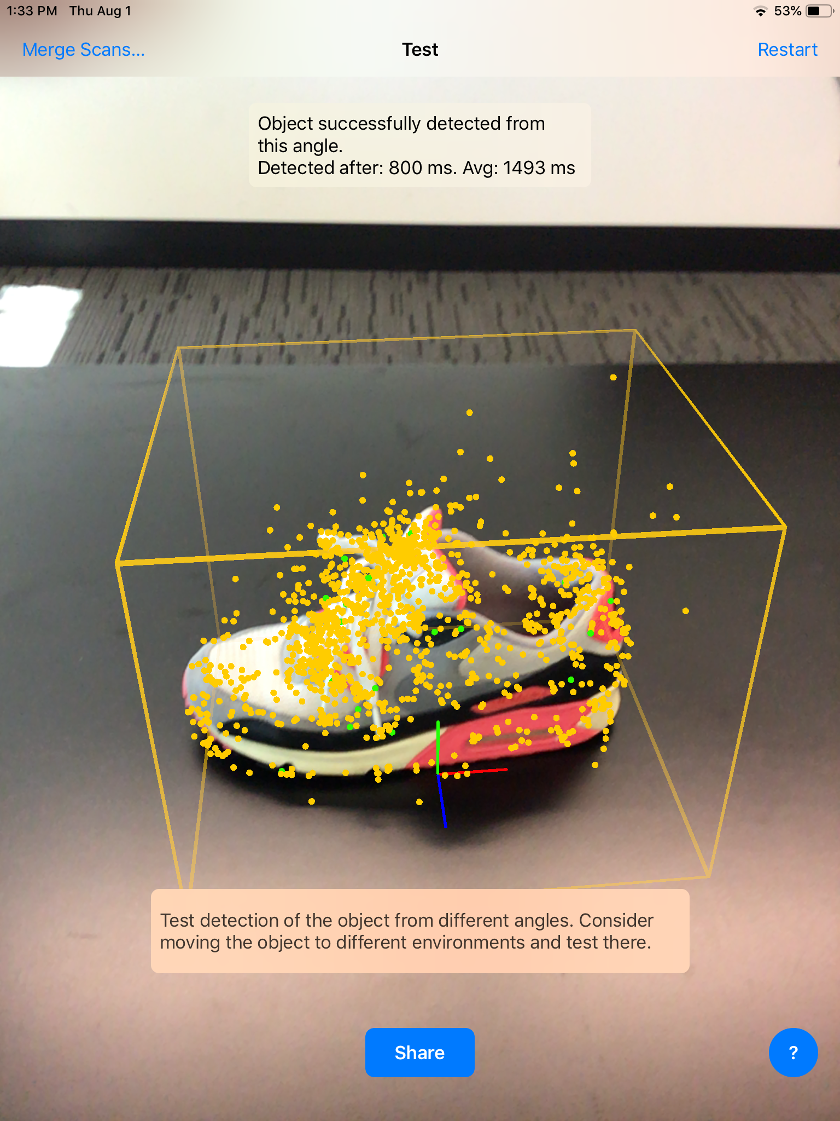
IMPLEMENTATION
Technologies
Swift 5
Xcode 11 Beta
ARkit 3.0
Apple's 3D Scanning App
iOS 12+ compatible devices
MARK
Notes:
John
- Here are the technologies we used for our full stack implementation. We developed with Swift 5 on the latest beta of Xcode which comes with ARkit 3.0 pre-installed. Scanning of shoes was made possible with Apple's 3D scanning app that allows a user to define a bounding box, scan all sides of a shoe and generate a 3D point cloud model. This new feature is called 3D Object Detection which I will now proceed to showcase with a live demo.

Slide 6
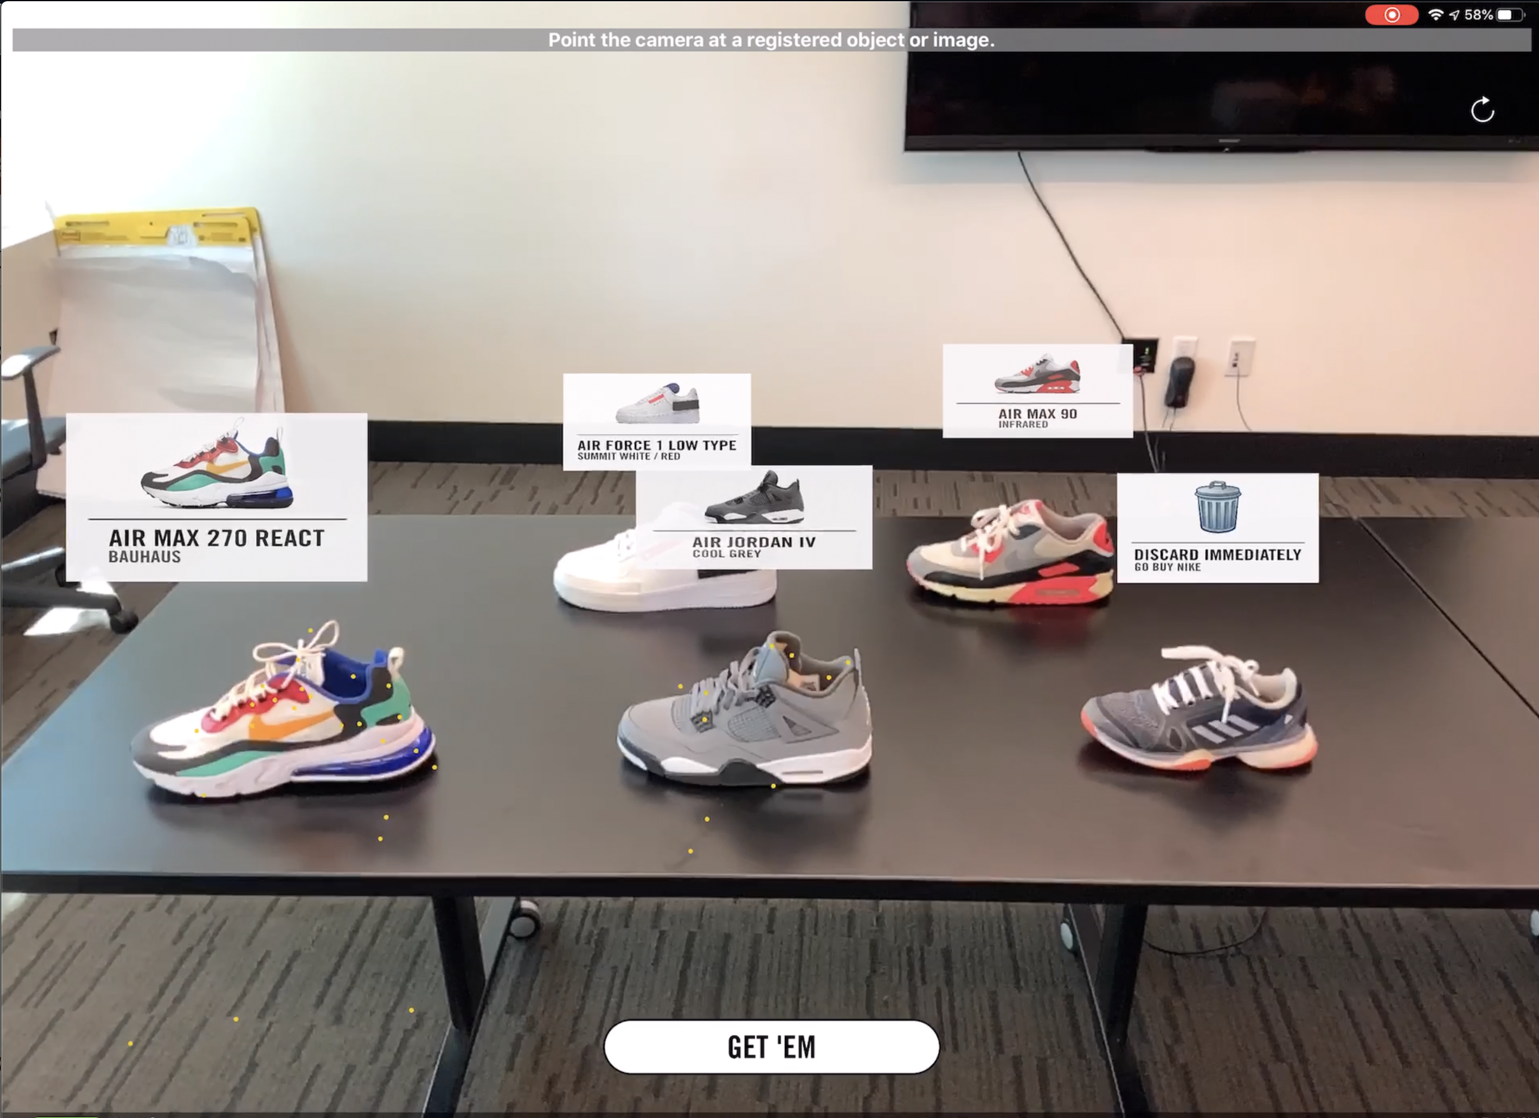
LIVE DEMO
MARK
App that identifies shoes using AR and 3D object detection
User can see shoe information overlaid in AR space
Provides user with button link to buy the shoe on Nike.com
Easily integrate into the Nike app as a feature
MARK
Notes:
John
- As the app boots up, you can see that it is detecting the feature points on the shoe such as color and shape. This is then send to our backend which is analyzing if the shoe is registered scan from our database. The result once it is done is that a pop up will appear indicating the shoe name, color, and image.
We've also implemented a button that when clicked, takes you directly to the nike.com product page of the shoe. You can then login with your Nike+ account, select your shoe size, I'm a big boy size 13, and add to your cart for checkout. This can work with multiple shoes as shown above on the screen. Our vision is that this can be implemented as a feature in the current Nike app. Now that you've seen our technology, let's revisit Jason's problem with Stephanie, who has our app installed.

Slide 7
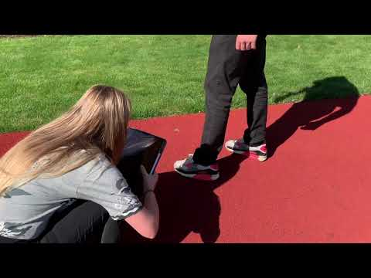
WHAT ARE THOSE?

Slide 8
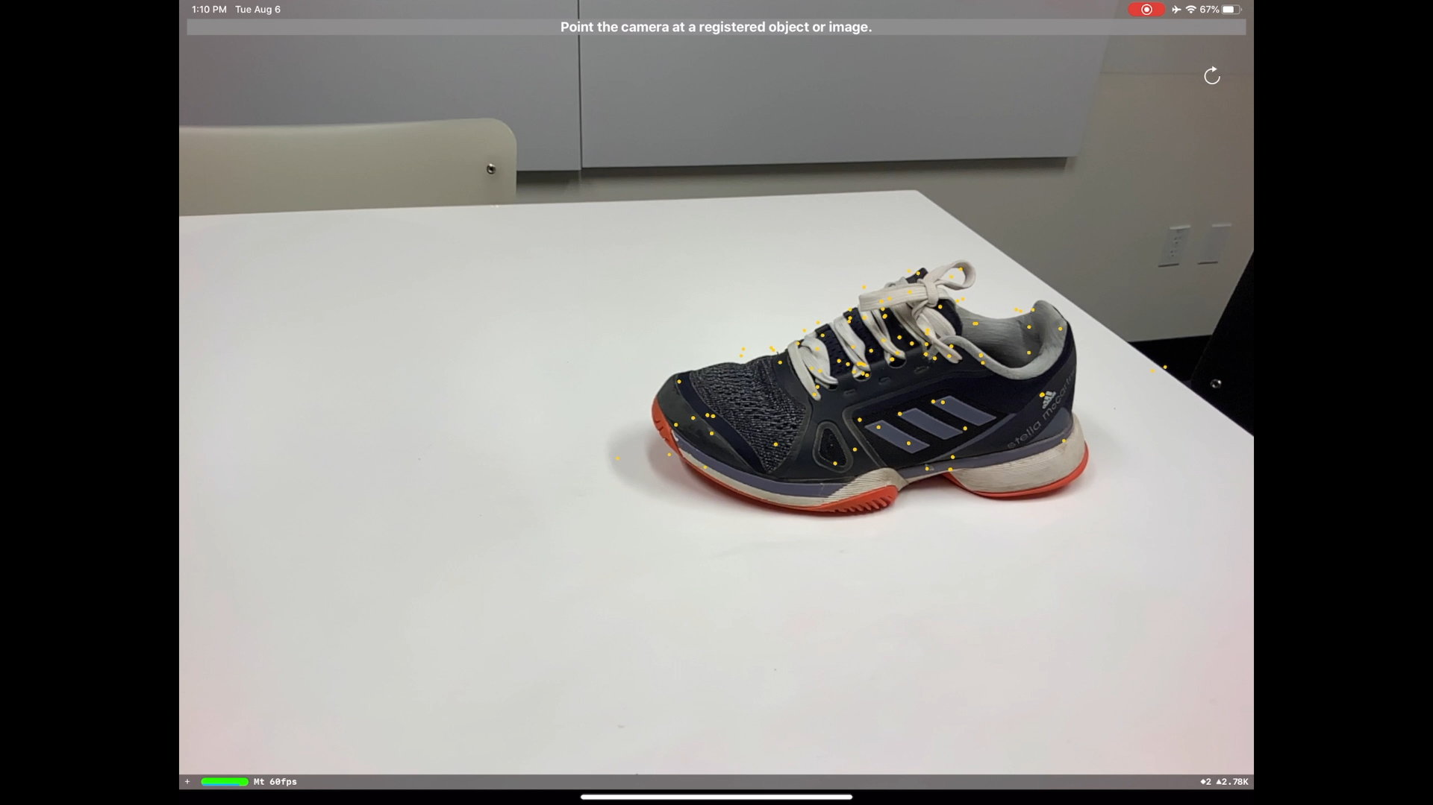
Notes:
John
And then as a fun little Easter egg, this is what happens when you try to scan a certain competitor's shoe *play video*
Link to this video if youtube link is needed: https://youtu.be/77DDUVk_YxE

Slide 9



IMPACT ON NIKE
NIKE Direct
Customer
Brand
Increase traffic to Nike.com at specific PDPs
Eliminate searches for Nike shoes on external sites
Streamlined, direct process between impression and purchase
Customer recognition of shoe models
Brand Nike as a growing technology company
Increase product visibility, brand exposure
MARK
Notes:
Kami –
We see our app as having 3 major impacts on Nike.
First, we’ll increase traffic to Nike.com at specific PDPs. The app points a user directly to Nike.com, eliminating the frequency at which customers start searching for shoes on other websites.
Second, this app supports Nike’s customers by reducing search time. In the same moment of a customer’s first impression of a product, they now have the ability to instantly make a purchase, for the fastest, most direct shopping experience possible.
Lastly, MARK helps Nike continue pushing its brand as an emerging technology company. Nike will be the first apparel brand to integrate object recognition into its shopping experience. Integrating a feature like this will be extremely advantageous to Nike’s technology reputation and allow Nike to set a precedent among competitor brands. Even if the user decides not to purchase, they’ve learned more about a new Nike shoe. This is a great benefit for Nike’s product visibility and brand reach.

Slide 10



ROLLOUT STRATEGY
On Campus
Specific Geos
Worldwide
Pilot product at WHQ (stand alone app)
Highest concentration of Nike Footwear
Easy to gauge user engagement & satisfaction before expanding
Release in specific Geo at first (Tokyo 2020)
Release in Nike App
Get feedback, update, prepare for global expansion
Release on Nike app for all geos
Reaches global customer base in the most efficient manner
Constant monitoring
MARK
Notes:
Chirag –
3 prong

Slide 11
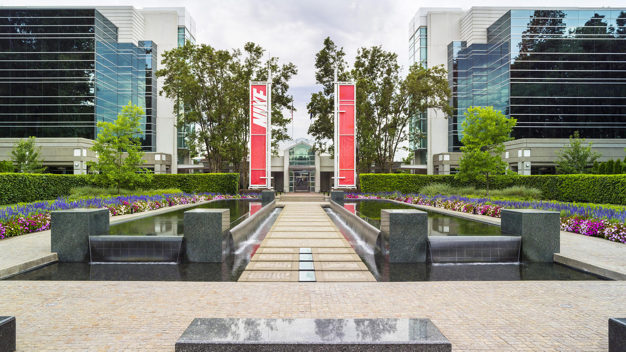
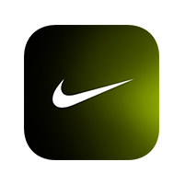

TIMELINE
OCT ‘19
NOV ‘19
DEC ‘19
JAN ‘20
FEB ‘20
MAR ‘20
APR ‘20
MILESTONE 1 Finish scanning current season shoes + previous 20 seasons
MILESTONE 2 Release product on WHQ, test + collect feedback
MILESTONE 3 Make adjustments to product based on feedback
MILESTONE 4 Begin integrating with Nike app
MILESTONE 5 Release at WHQ again, test + collect feedback
MAY ‘20
JUN ‘20
JUL ‘20
AUG ‘20
SEP ‘20
OCT‘20
NOV ‘20
MILESTONE 6 Make adjustments, incorporate feedback
MILESTONE 7 Prep for Tokyo Launch
MILESTONE 8 Launch in Tokyo, test + collect feedback
MILESTONE 9 Incorporate feedback, prep for Global launch
MILESTONE 10 Global Launch on Nike app
MARK
Notes:
Chirag
Highlight 3 main milestones

Slide 12
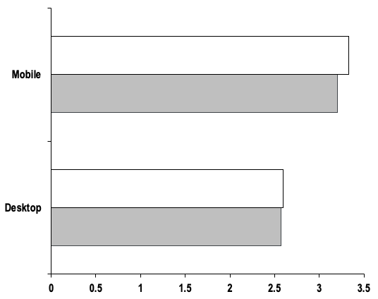
PROJECTED GROWTH
~. 4
Nike June 2019 Traffic For Mobile and Desktop Users
PERCENT INCREASE
Mobile monthly conversion rate
Projected Mobile Traffic Growth – 3.33
~. 1
PERCENT INCREASE
Current Mobile Traffic – 3.20
Desktop monthly conversion rate
~10000
PURCHASE INCREASE
Projected Desktop Traffic Growth – 2.59
Mobile monthly purchases
Current Desktop Traffic – 2.57
~$1,000,000
Mobile monthly revenue increase
(Millions of Users)
MARK
Notes:
Chirag
Just talk about increase and how it reflects the numbers in the graph
1000s of more monthly purchases

Slide 13
our strategic plan
Nike’s Triple Double
2x
2x
2x
Innovation
Direct
Speed
END-TO-END DIGITAL TRANSFORMATION
To serve the consumer in new ways
MARK
Notes:
Brian- Our app ties directly into all aspects of Nike's Triple Double Strategic Plan. Nike will double its cadence and impact of innovation by bringing the revolutionary MARK app to its consumers. Such an innovative digital experience will disrupt the playing field and will set Nike far ahead of its competitors.
Nike will also double its direct connections with consumers by enhancing and expanding Nike's membership experience on an increasingly global scale. Fueled by the Consumer Direct Offense, Nike will foster its direct-to-consumer pipelines and serve consumers instantly through its app experiences.
Increasing Nike's Innovation and Direct Channels and reaping the benefits will in turn allow Nike to start doubling its speed to market through investments into its end-to-end digital capabilities to serve the consumer faster.

Slide 14

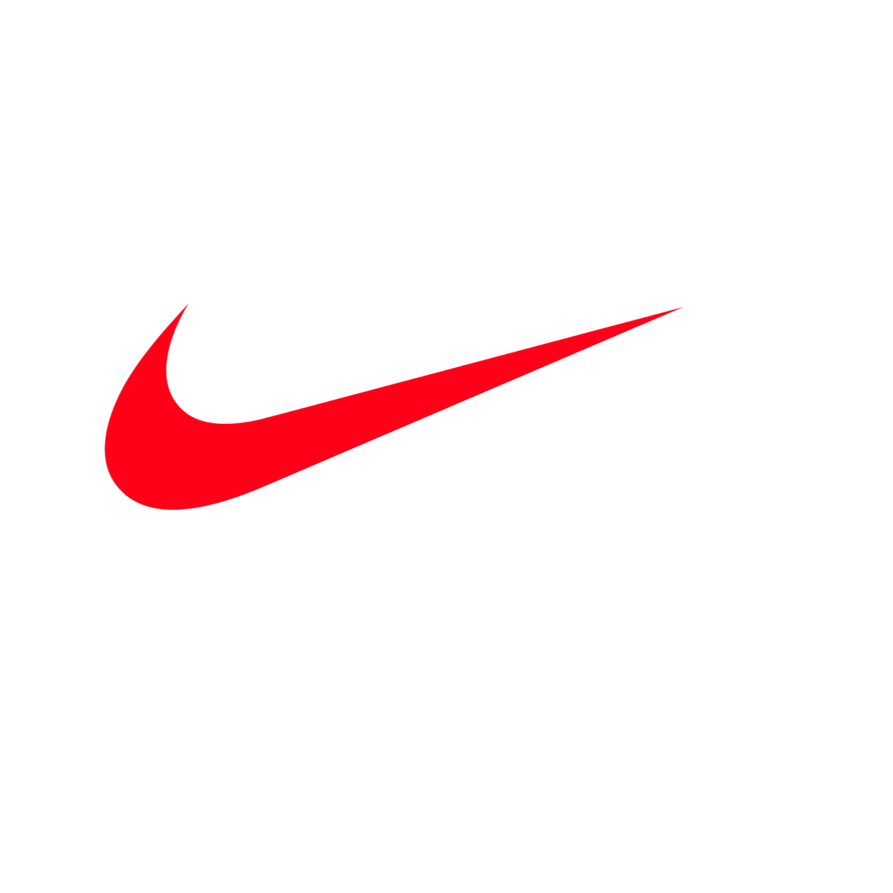
THANK
YOU!
Notes:
Steph

Slide 15

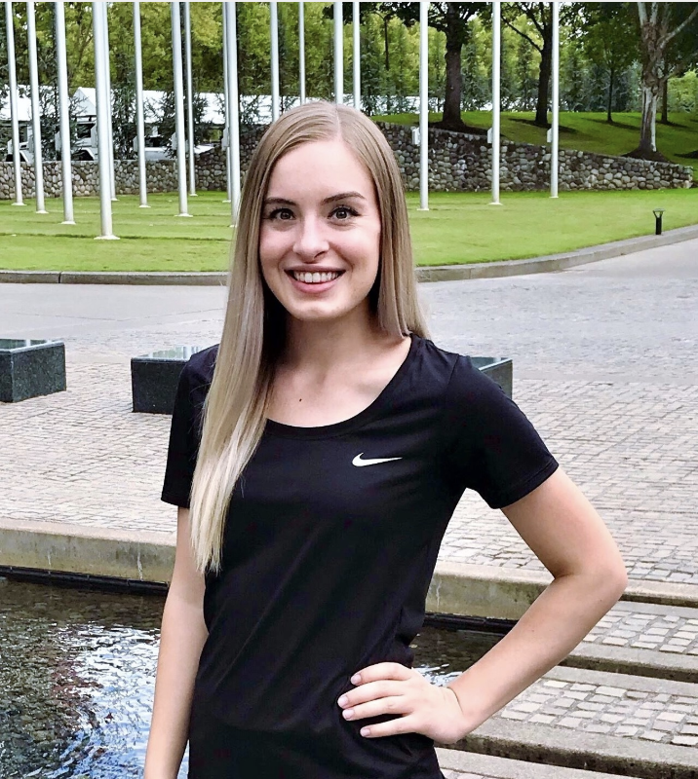


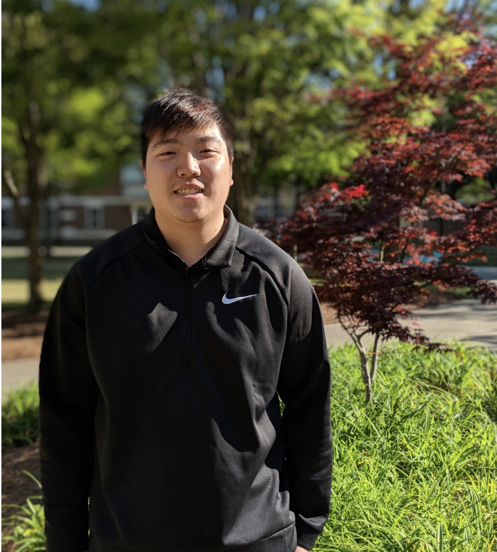

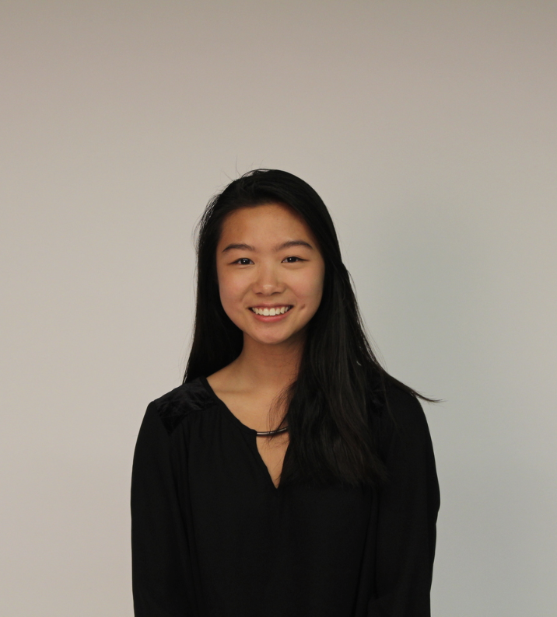




THE TEAM
Jason Lomsdalen
SOFTWARE ENGINEER INTERN
TANNER MORSE
SOFTWARE ENGINEER INTERN
JOHN HO
SOFTWARE ENGINEER INTERN
STEPHANIE HUGHES
NIKE TECH ENGINEER INTERN
CHIRAG NARAYANAKERE
Product Owner INTERN
BRIAN HOU
SOFTWARE ENGINEER INTERN
KAMI CHIN
SOFTWARE ENGINEER INTERN
MARTA WILCZYNSKI
NIKE TECH ENGINEER INTERN
ANNETTE COCHRAN
QUALITY TOOLS DEVELOPMENT INTERN
DAVID ARES
COACH
David SHEFCHIK
COACH
MARK

